Slide 1


Department of Information Technology
presents
AI-Powered
Classroom Attendance Automation
Arijit Banik
Monaswi Kumar Bharadwaj
Guided By:
Prof. Shikhar Kumar Sarma

Slide 2



Attendance inefficiencies in classrooms
Manual Roll Calls
Wastes valuable class time for teachers and students.
Proxy Attendance
RFID technology allows students to skip class unnoticed.
Inaccurate Data
Current systems fail to provide reliable attendance records.

Slide 3

How FACIDANCE Works
Enrollment
Students enroll by uploading three facial images to create a secure identity profile.
Capture
Matching
Classroom cameras capture a single frame containing multiple faces.
AI instantly matches detected faces with enrolled profiles and marks attendance automatically.

Slide 4
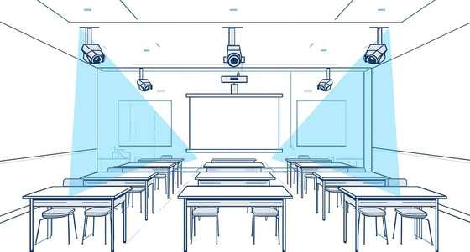


Seamless Deployment of Facidance System
No new hardware
Utilizes existing cameras for easy integration
Zero learning curve
Easy setup ensures teachers can adapt quickly
No privacy issues
Data protection is prioritized with our system

Slide 5

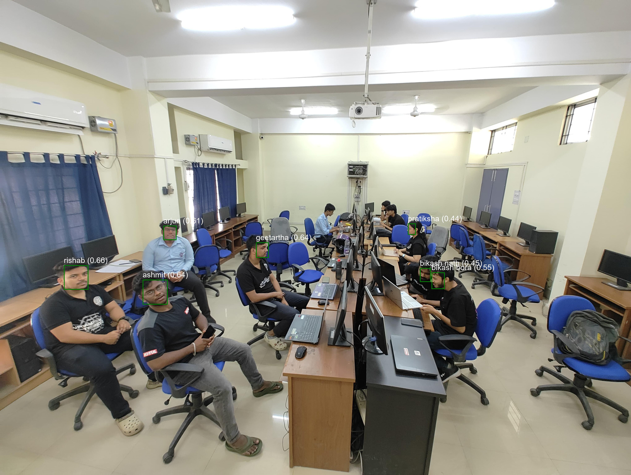
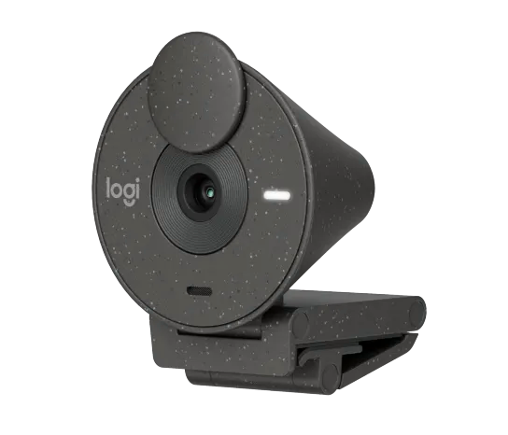



Live, Camera-Based Attendance Recognition
Logitech Brio 300
HD Capture Wide FOV
Live Capture
Faces detected in real time
AI Recognition
Multiple students in one frame
Instant Attendance
Auto-Marked & logged securely

Slide 6


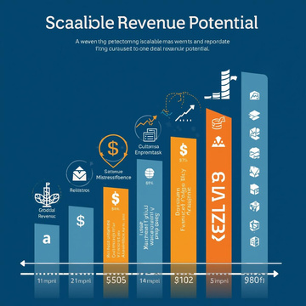

Large & Growing Market
Higher education, schools, coaching centres, and training institutes drive continuous attendance needs.
High-Pain, Low-Automation Segment
Market
Opportunity
Most institutions still rely on paper-based or basic digital attendance systems.
Scalable Revenue Potential
Subscription-based SaaS ensures scalable deployment with predictable recurring revenue.
Strong TAM Potential
Smart attendance solutions represent a ₹2,400 Cr total addressable market with strong scalability.

Slide 7

Investment Opportunity
₹10L
36x
5Mn+
Seed Round Ask
Revenue Multiple
Student Lives Impacted
Seed capital to deploy pilots across 10 institutions, strengthen product reliability, and convert early traction into recurring revenue
Comparable SaaS EdTech exits in India (Classplus, Teachmint) valued at 30-40x ARR
Scalable roadmap enabling adoption across 1,500+ institutions

Slide 8

Thank You

